Slide 1
Rotor Egg Drop
Tim Taylor
National Event Supervisor

Slide 2
Disclaimer
This presentation was prepared with the rules from the coaches manual. There may be differences in the way the event is run at all levels due to the interpretation of the rules by the event supervisor. Read the rules carefully and if questions still exist, file an event clarification.

Slide 3
Description
A team will construct an unpowered, autorotation helicopter device, which uses one or more helicopter rotor(s) to safely transport a raw chicken egg from a specified height to the floor.
A Team of up to 2 Impound – Yes
Approximate Time – 10 minutes
Ten minutes to drop but additional needed time to attach the plastic bag and egg to device.

Slide 4
Event Parameters
Students may bring only one prebuilt helicopter egg drop device
No other tools or equipment are allowed.
The device may be in a protective storage container for impound.

Slide 5
Event Parameters
A raw, grade A large chicken egg will be sealed in a plastic sandwich bag which will then be placed in a 3 ounce paper cup.
There are different types of sandwich
bags. Be prepared for all!!
The egg, bag, cup, scissors and masking tape to attach the cup to the device and seal the bag (if needed) will be provided by the event supervisor.
Be prepared to seal the bag and not seal the bag.

Slide 6
Construction Parameters
The device must use wings or blades that rotate around a central axis to slow the descent of the egg, using aerodynamic principles of a helicopter rotor in unpowered “autorotation” mode.
No Chinook designs
The rotors HAVE to rotate without student help.
The rotors cannot rotate on their own before launch.
No energy-producing mechanism of any type may be used to power the rotor(s) to slow the descent of the device.
This is NOT Helicopters.

Slide 7
Construction Parameters
No commercial rotor assemblies may be used.
Similar to Helicopters
The device must not be or contain an airplane, a balloon or a parachute.
Students must seal the egg in the provided plastic sandwich bag and place it in the provided cup.
Do not bring a cup attached.

Slide 8
Construction Parameters
Students must mount or suspend the cup from the bottom of the helicopter device in such a position that the cup is the first thing to contact the floor.
Tier 3 or 4 if any part of the device hits the floor
before the cup – Construction Violation.
Students may use the provided masking tape to attach the egg and cup to their device.
Be aware of a different type of tape or limited
quantity.

Slide 9
Construction Parameters
No other shock absorbing or cushioning materials can be used either inside (including trapped air) or outside the bag or cup to protect the egg before the cup contacts the floor.
Try to get as much trapped air out of
the bag as possible.
Do not pack the extra plastic bag into
the bottom of the cup.

Slide 10
Construction Parameters
The entire device, including the cup in launch and flying configuration, must fit into a 51 cm x 51 cm x 51 cm cube in any orientation.
There is a shipping box that has these
exact dimensions.
Can’t position in box in one way and then
launch in a different position.

Slide 11
Competition
It is recommended that the event take place indoors, but if the event is held outdoors, teams must by notified of the location prior to the tournament date.
Football stadiums, outside stair cases

Slide 12
Competition
The entire helicopter must be impounded and weighed before the start of the event.
A big area for impoundment will be
required.
No modifications are allowed after impound other than to attach or extract the egg and cup from the helicopter.
Have your device ready to go. Some
competitions will check them in and
allow modifications, others will accept
and then handle the devices while you
are not there (Breakage???)

Slide 13
Competition
The device will be released from impound when the team has finished competing.
Scoring – No appeals can be filed or
processed after a device leaves the
impound area.
May have to explain to event supervisor
why you are not taking device but also
remember once the competition is done,
the event supervisor will no longer
watch your device.

Slide 14
Competition
If the egg is broken by the competitors before the drop, they may request another egg, with a penalty of two seconds subtracted from their final time.
BIG Penalty
Accidents will happen
PRACTICE, PRACTICE, PRACTICE
loading and unloading the egg.
Supervisor will provide scissors for
opening the bag, if needed.

Slide 15
Competition
There will only be one drop for each helicopter.
Too time consuming if multiple drops
and running up and down stairs.

Slide 16
Competition
All teams must drop their device from the same designated height. The drop height will be announced on the day of the tournament. It is recommended that the drop height be the maximum that the site will accommodate with a minimum height of five meters.
Drop height announcement after impound
Higher the better – Nationals 13.87 m
Some places may not have the 5 meters
minimum.

Slide 17
Competition
Time starts when the device leaves the student’s hand and stops when any part of the device touches the floor or the judges otherwise determine the flight is over.
Should be a student countdown.
Timers need to watch the drop also.
Multiple floors – device goes into one and
out of site.
Drafts or heating and cooling systems are not
going to be controlled.

Slide 18
Competition
It is suggested that three separate timers be used and the final time will be the MEDIAN (middle) of the three times. Timing should be to the nearest 0.01 second.
Suggested but not always happening

Slide 19
Competition
After the drop the student is responsible for extracting the egg from the cup and sandwich bag and handing it to the event supervisor for inspection.
The student, NOT THE EVENT SUPERVISOR but be
prepared!!!
Those helicopters whose egg did not survive will be ranked below those that survived.
A broken egg is defined as a crack leaving a wet spot on a paper towel.
Just like ALL of the other egg drops

Slide 20
Competition
Once the device is removed after testing, there can be no further challenges for scoring or ranking.
Difficulties for Event Supervisor
Watching devices with arbitrations
Seeing how many more devices to
drop, if a walk in event.
Protection of devices once
competition is over and devices
are left - arbitration or just sitting.

Slide 21
Scoring
Teams will be ranked by the greatest descent time within each Tier, greatest time wins.
2103 Wright State Invitational
13.87 meters
8.84 seconds to 1.17 seconds
Mass – 8.3 g to 136.6 g
2013 Ohio State Tournament
15.4 meters
9.56 seconds to 1.62 seconds
Mass - 9.2 g to 91.3 g
2013 National Tournament – Wright State
13.87 meters
9.32 seconds to 2.68 seconds
Mass – 6 g to 83 grams

Slide 22
Scoring
The helicopters whose egg did not survive will be ranked below those that do.
Tiering system

Slide 23
Scoring
Helicopters not meeting construction/competition parameters will be ranked below those that do.
Remember the cup must hit the floor
first!!!
The tie-breaker is the mass of the heaviest helicopter (without the egg and cup).
All devices should be tested so each has a score for arbitration.

Slide 24
Scoring Tiers
The base score is the team’s longest descent time.
Teams must be tiered as follows:
Tier 1: Met construction/competition
parameters and the egg survived
Tier 2: Met construction/competition
parameters and the egg did not
survive

Slide 25
Scoring Tiers
Tier 3: Did not meet construction/competition
parameters and the egg survived
Tier 4: Did not meet construction/competition
parameters and the egg did not
survive

Slide 26
Scoring Tiers
2013 WSU Invit. 2013 OSU 2013 Nationals
Tier 1 22 30 37
Tier 2 11 6 3
Eggs “died”
Tier 3 14 2 13
Cup did not hit first
Tier 4 2 1 7
No Show 7 1

Slide 27
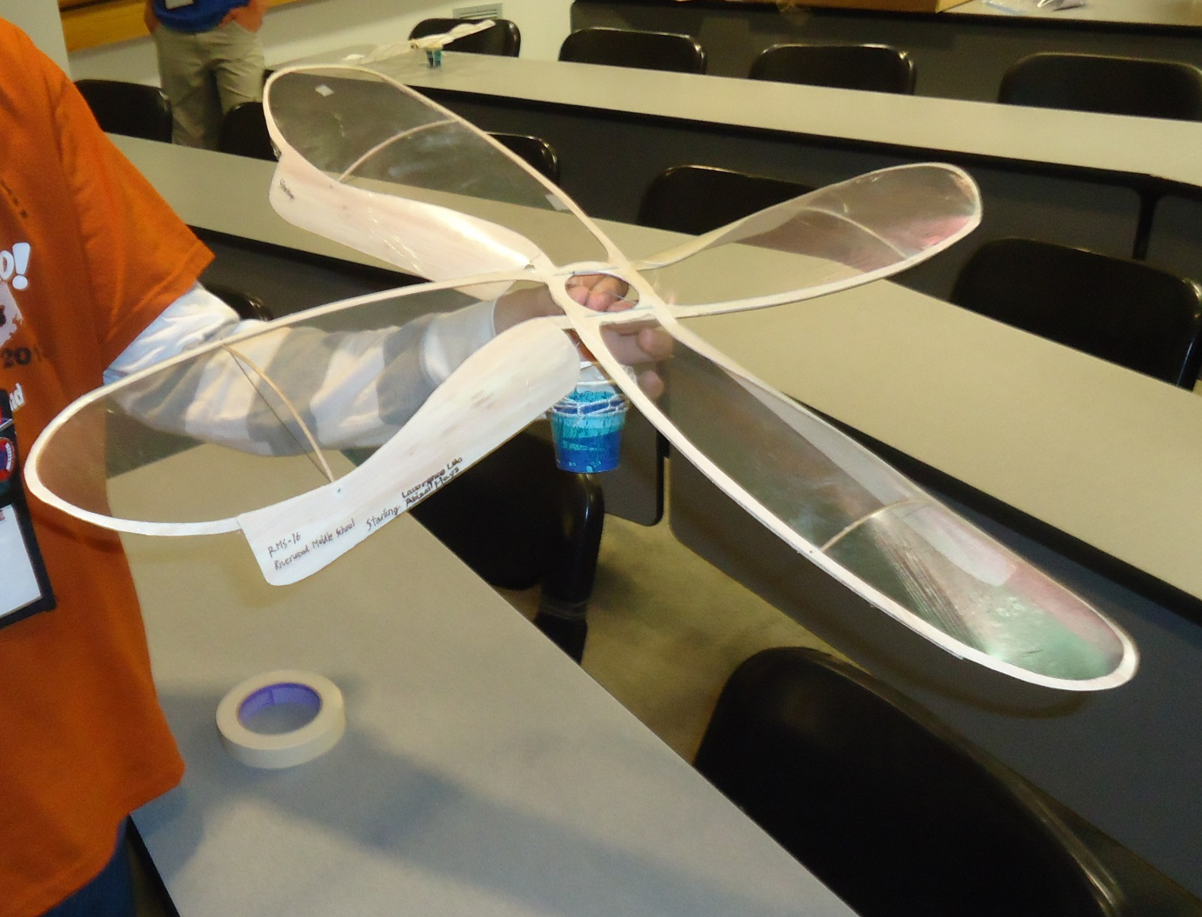
1st Place 2013 Nationals
9.32 seconds
10 grams

Slide 28
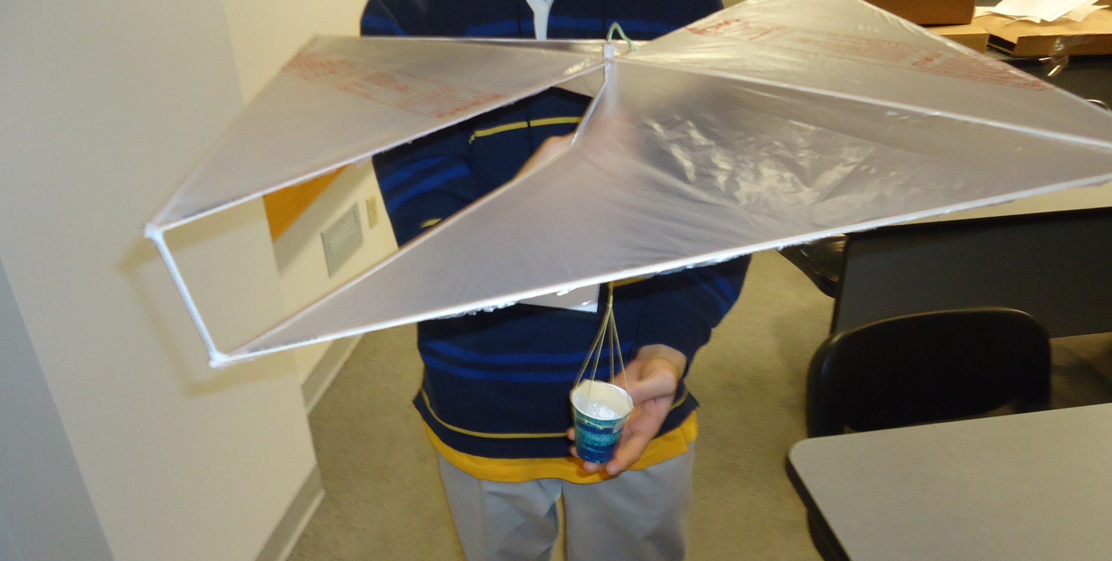
2nd Place Nationals
9.25 seconds
9 grams

Slide 29
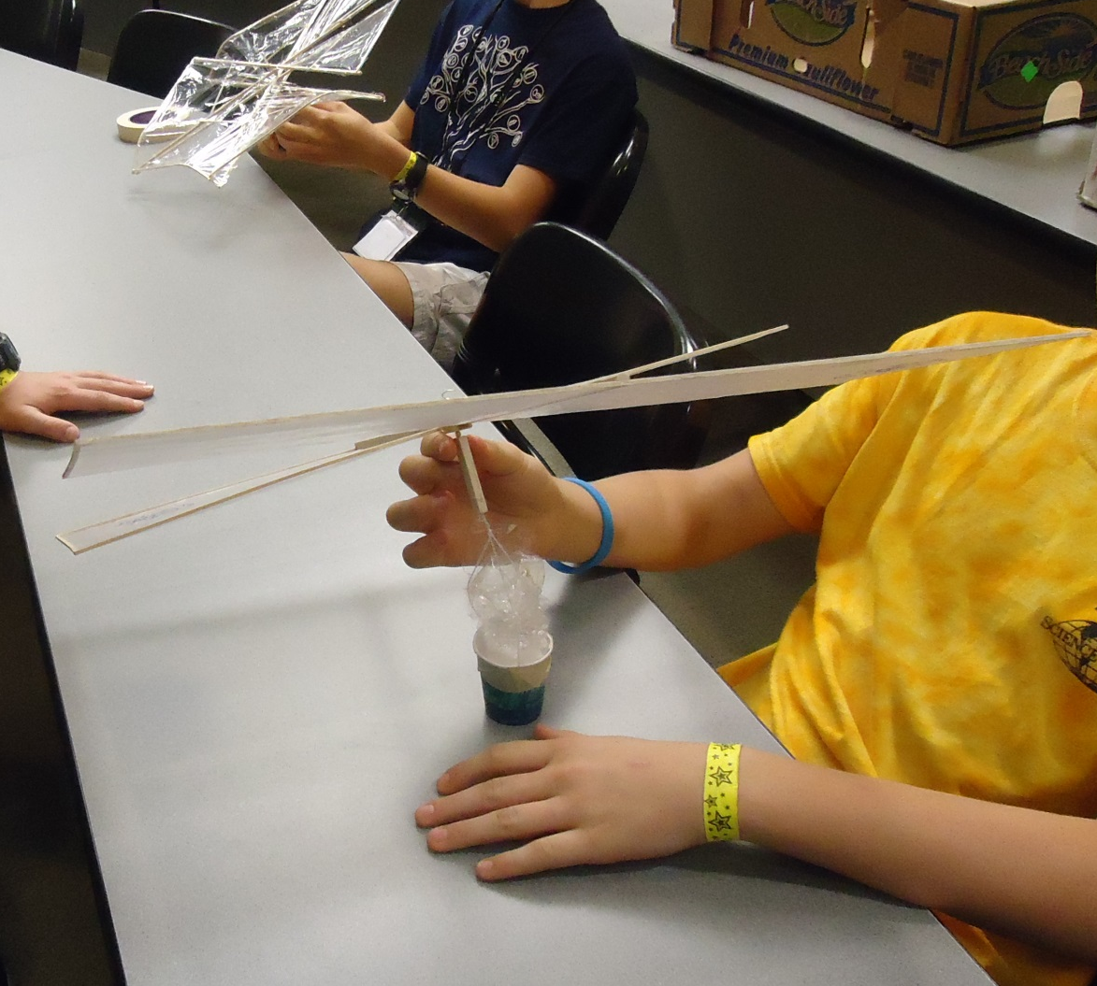
3rd Place Nationals
9.16 seconds
11 grams

Slide 30
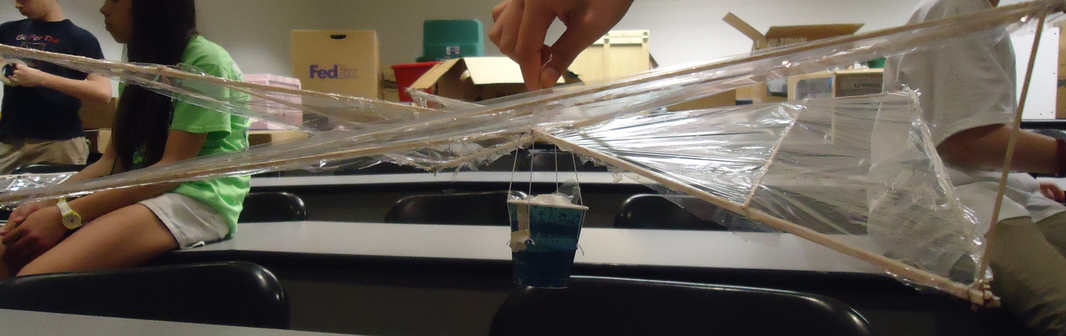
4th Place Nationals
9.06 seconds
9 grams

Slide 31
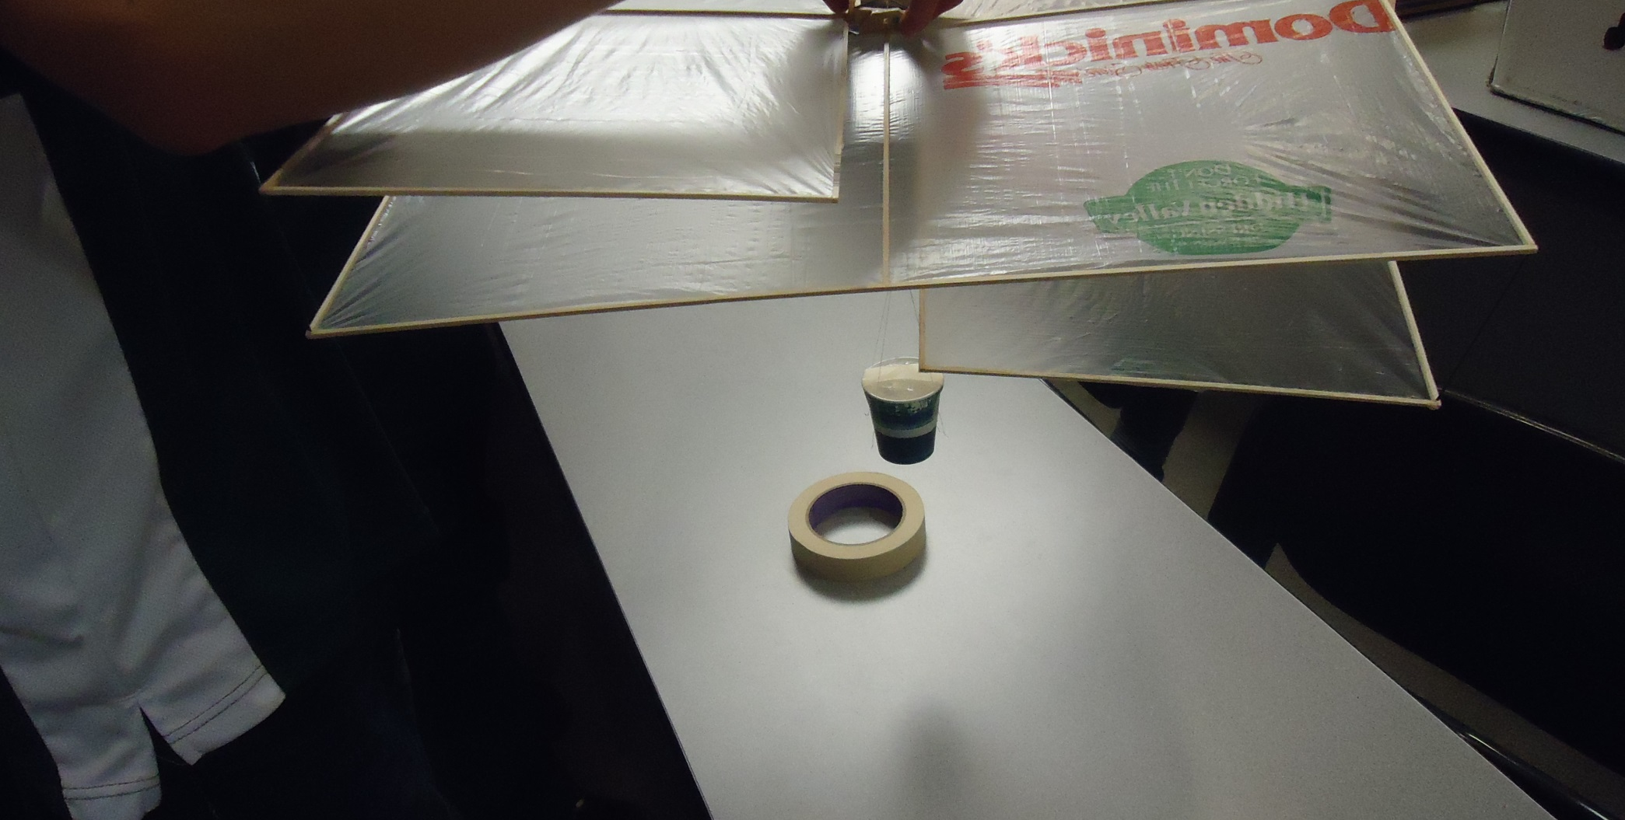
5th Place Nationals
8.00 seconds
11 grams

Slide 32
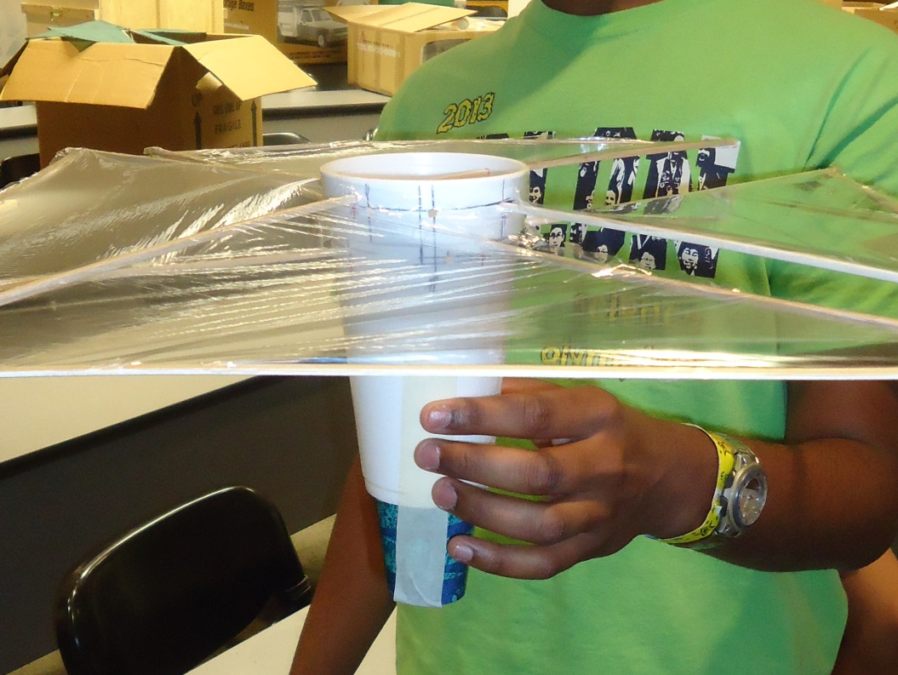
6th Place Nationals
8.00 seconds
13 grams

Slide 33
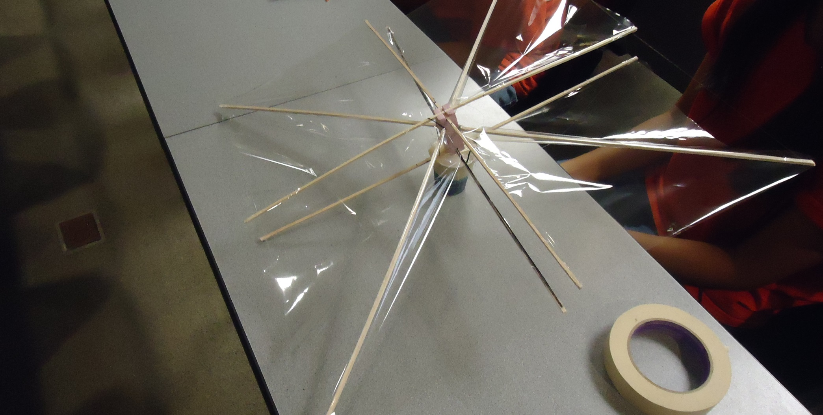
7th Place Nationals
7.75 seconds
13 grams

Slide 34
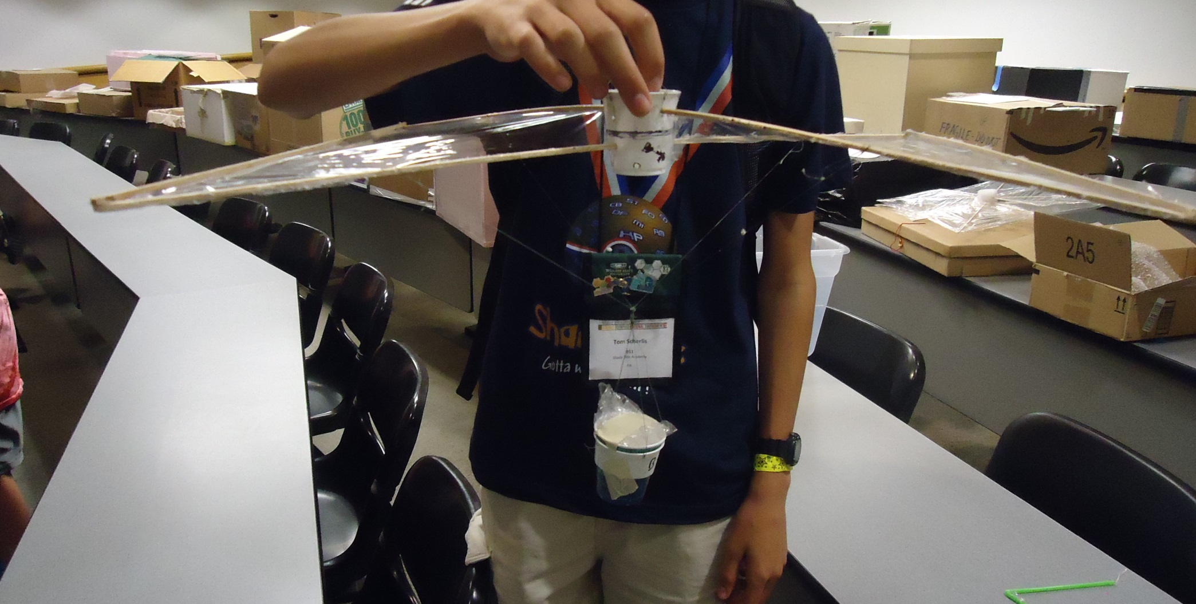
8th Place Nationals
7.75 seconds
14 grams

Slide 35
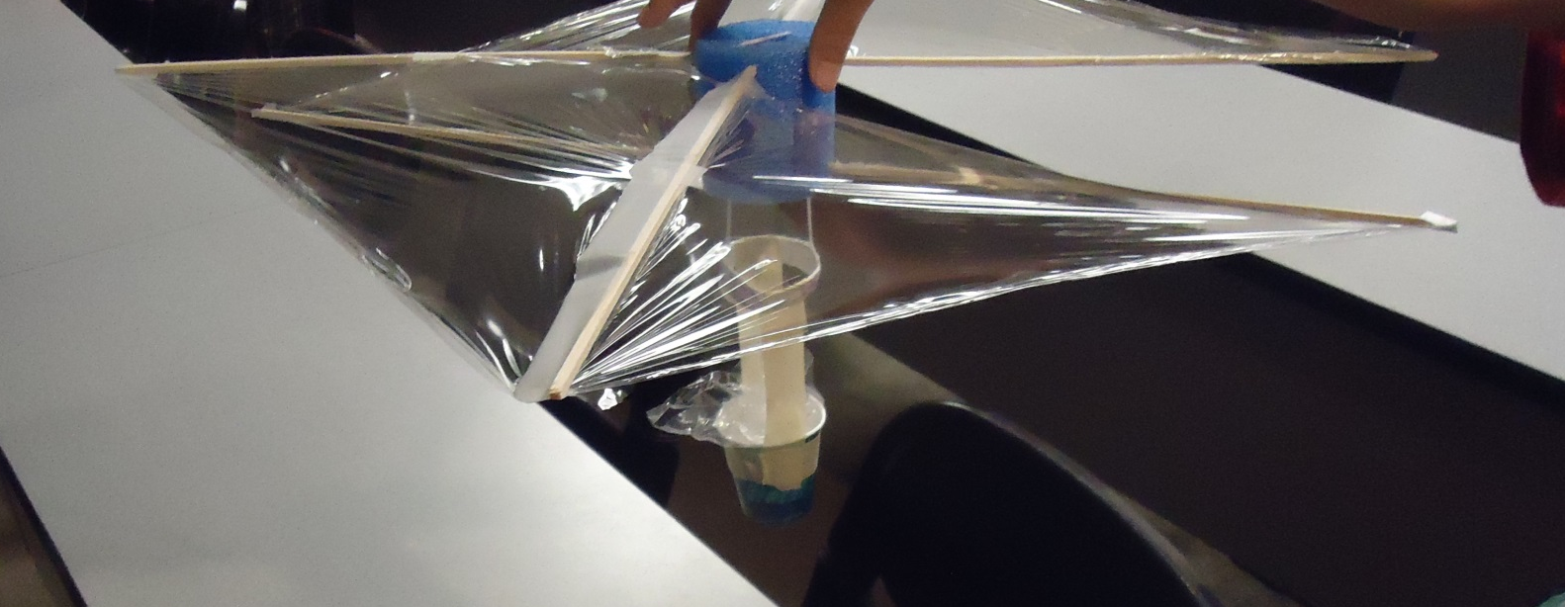
9th Place Nationals
7.59 seconds
12 grams

Slide 36
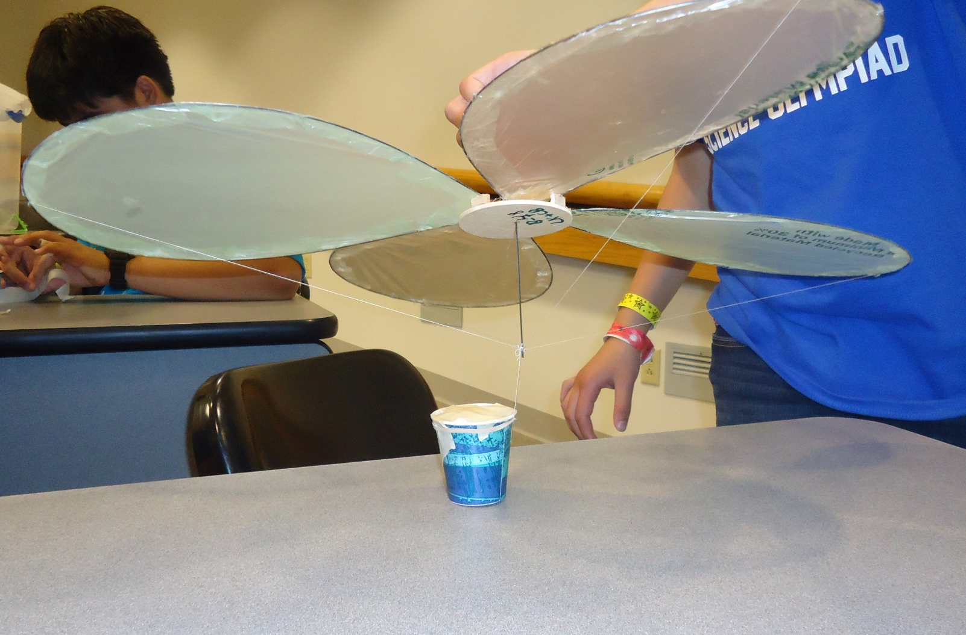
10th Place Nationals
7.59 seconds
13 grams

